Slide 1
Content Based Fashion Recommendation
Kushal Doshi - kd633
Malhar Khimsariya - msk200
Nidhi Arun Harwani - nh417
Vivek Dhandha - vd264

Slide 2
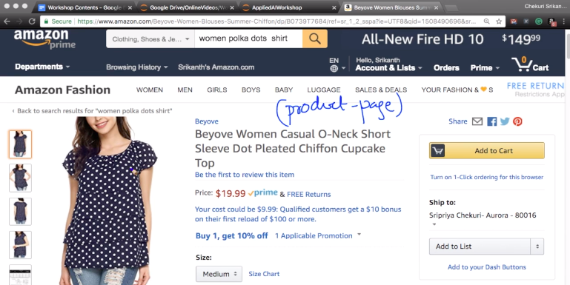

Slide 3
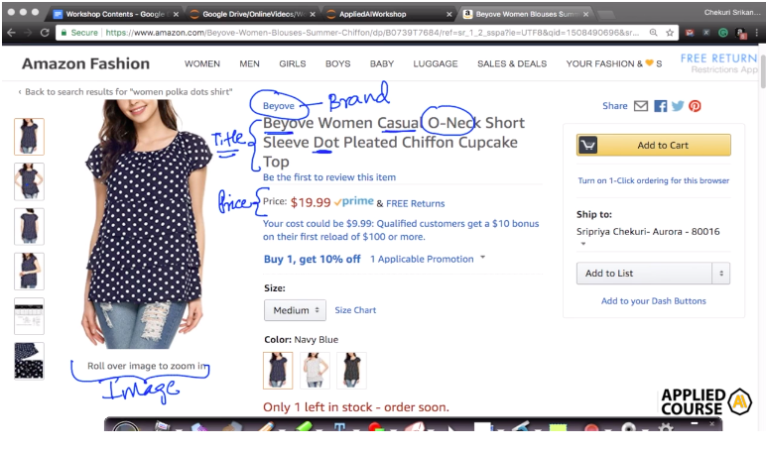

Slide 4
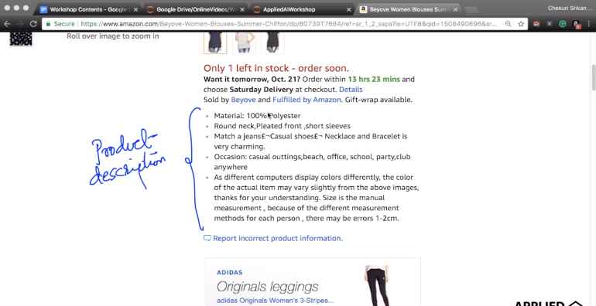

Slide 5
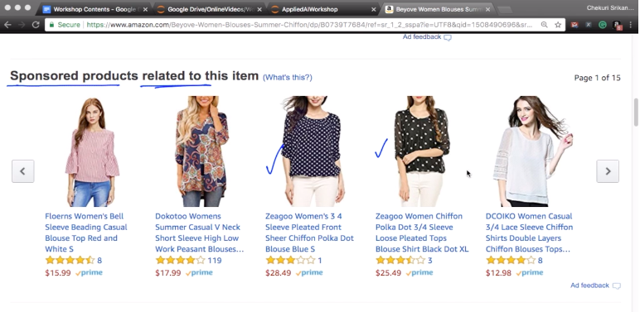

Slide 6
Features Used
Asin (Amazon Standard Identification Number)
Brand
Color
Product_type_name i.e. what kind of the product it is
Medium_image_url
Title
Formatted_price

Slide 7
Elimination of features based on missing values
The total data is around 183k.
There are approx 150k data rows where the price of the product is null.
We remove these rows to get the useful data
Similarly, we remove data where the color is set to null.
This brings our data from 183k to 28k.

Slide 8
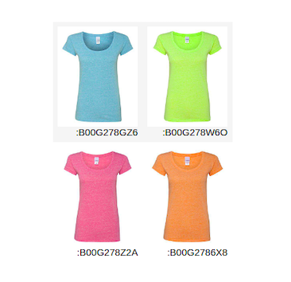
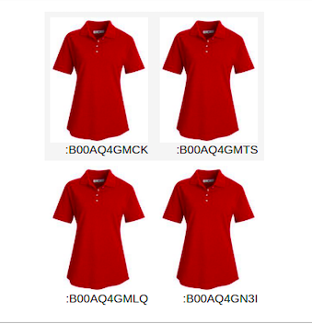
Duplicate Data
The 4 T-shirts given are the exact same in different sizes.
These products have different asin.
So, we have tried to remove such duplicate data.

Slide 9
Duplicate Data
Similarly, these 4 tops are the same in 4 different colors.
So, we need to remove the duplicate items and keep only one of these to represent the product.

Slide 10
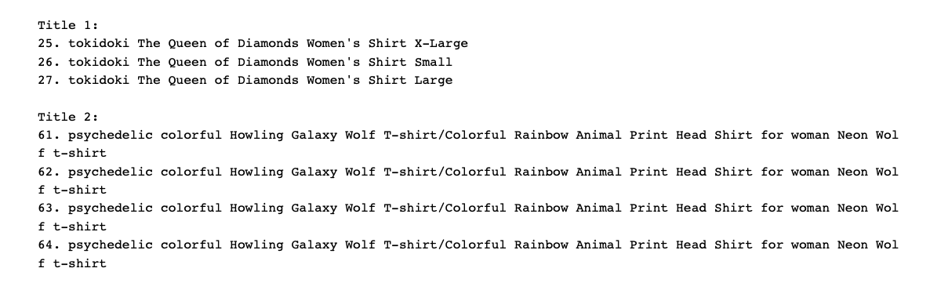
Duplicate Data removal
From the above figure, we can see that the titles in example one only differ at the end. And there are also products which have the same title and the change is only in the identification number.
To remove this duplication, we sort the data in alphabetical order of titles. Then, we remove the titles in which only the size or color differs.

Slide 11
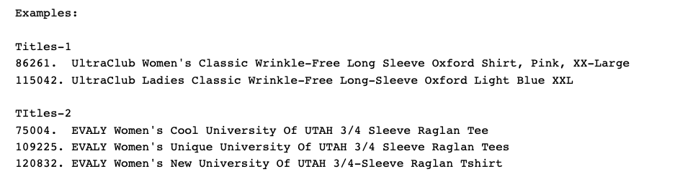
Duplicate Data Removal
There are also titles which are not adjacent but very similar to each other.
We use Fuzzy String Matching using edit distance for this type of deduplication process.
An example of such titles is given below.
After these two steps of deduplication, our data goes down to 16k.

Slide 12
Preprocessing Data
In this step, we preprocess the title of the products to get only the relevant information. To do this, we remove the following from the titles:
Punctuations
Special Characters
Stop Words
URLs
HTML Tags

Slide 13
Text Based Similarity Techniques
1)Bag of words:In this approach, we use the tokenized words for each and found out the frequency of each token. Example: Doc1 = John Likes movies. Doc2 = Mary Likes movies too.
 | Likes | movies | Mary | too | John
Doc1 | 1 | 1 | 0 | 0 | 1
Doc2 | 1 | 1 | 1 | 1 | 0

Slide 14
Text Based Similarity Techniques
2)TF-IDF : It stands for Term Frequency - Inverse Document Frequency.
[1] TF (t, D) = frequency of word in Document D / Total number of words in Document D
[2] IDF (t) : Log (Total Number of Documents in the corpus / Number of Documents containing word
Example: Doc1 = John Likes movies. Doc2 = Mary Likes movies too John Likes Movies Mary Too
 | John | Likes | Movies | Mary | too
Doc1 | 0.7049 | 0.5015 | 0.5015 | 0 | 0
Doc2 | 0 | 0.4099 | 0.4099 | 0.5761 | 0.5761

Slide 15
Text Based Similarity Techniques
Word2vec: Word2vec takes as its input a large corpus of text and produces a vector space, typically of several hundred dimensions, with each unique word in the corpus being assigned a corresponding vector in the space.
Word vectors are positioned in the vector space such that words that share common contexts in the corpus are located in close proximity to one another in the space.
Once the title is converted into numerical vectors, we calculate the euclidean distance between the user query and each data point in our data.
We make recommendations by arranging the points in increasing order of the distances and select top 10 closest points. is technique is called as the nearest neighbor search.
In general, for an n-dimensional space, the distance is :
d(p, q) = square_root( (p1 − q1) ² + (p2 − q2) ² + · · · + (pi − qi)² + · · · + (pn − qn)²)

Slide 16
Image Feature Extraction
We need to represent each image to a vector .
We used Keras to implement Visual Geometry Group Convolutional Neural Networks( VBB CNN) on 16042 training data points of images(dim 224,224) to convert them to dense vectors of length 25088.
What we had as the output of the neural network is a vector representation of each image. When a query point was taken as the input, the euclidean distance between the query image and rest of the images was calculated from their vector representations.
Distances were sorted in ascending order and its top vectors’ row were the recommended product image for the user.

Slide 17
Thank you!

